Slide 1
All Judges Have Administrative Duties
Presiding Judge Judicial Oversight Obligations
Supervising & Site Judges
Delegated Authority for Judicial Oversight
All Judges Administrative Duties

Slide 2
Administrative Responsibilities of All Judges
diligently discharge administrative responsibilities
maintain professional competence in judicial administration, and
cooperate with other judges and court officials in the administration of court business.
Cal. Code of Judicial Ethics, Canon 3C(1), (2)

Slide 3
Administrative Responsibilities of All Judges
Hear all assigned cases unless disqualified
Notify the presiding judge on the completion or continuation of a trial or other assigned matter for hearing
Request advance approval for an intended absence of one-half day or more
Follow court’s personnel plan when dealing with employees
Follow directives of the presiding judge in matters of court management and administration
Cal. Rules of Court, rule 10.608

Slide 4
Administrative Responsibilities of All Judges
Declare conflicts of interest
Monitor submitted cases
Submission of timely salary affidavit
Fulfill education requirements
Conduct community outreach
Obligation to report counsel to state bar
Obligation to avoid conflict of interest in administrative responsibilities.
Duty to cooperate with a CJP inquiry.

Slide 5
Administrative Responsibilities of All Judges
Canon 3D(1) requires every judge to “take appropriate corrective action” when they have “reliable information that another judge has violated any provision of the Code of Judicial Ethics.”

Slide 7
Supervising Judge Duties
Presiding Judge must designate a presiding judge of the juvenile division, and a supervising judge for each division, district, or branch court (Rule 10.603(c)(1)(A)).
Presiding Judge may delegate any of the specific duties listed in Rule 10.603 to another judge (Rule 10.603(d)), including:
Judicial Assignments
Judicial Schedules
iii) Monitoring of Submitted Cases
iv) Oversight of Judicial Officers— incl. corrective action/CJP reporting
v) Budget and Finance
vii) Meetings and Committees
vii) Liaison with Judicial Council, local bar, community
viii) Planning
b. Supervising Judge of Criminal Division has specific duties set forth in Rules 10.950 and 10.951.
c. Presiding Judge of the Juvenile Court has specific duties set forth in Standard 5.40 of the Standards of Judicial Administration.
d. Presiding Judge of the Appellate Division has specific duties set forth in Rule 10.1104.
e. Presiding Judge of the Family Division has specific duties set forth in Standard 5.30 of the Standards of Judicial Administration

Slide 8
Supervising Judge Duties
A judge with supervisory authority for the judicial performance of other judges shall take reasonable measures to ensure the prompt disposition of matters before them and the proper performance of their other judicial responsibilities.
Cal. Code of Judicial Ethics, Canon 3C(4)

Slide 10
Disciplinary Authority over Judicial Officers
Judges
Only the Commission on Judicial Performance (CJP) is authorized to discipline judges. Cal. Const. Article VI, section 18.
Commissioners
Presiding Judge has primary jurisdiction to discipline subordinate judicial officers but must report discipline to the Commission on Judicial Performance. Cal. Rules of Court, rule 10.703.

Slide 11
Supervising Judge - Expectation re Handling Judicial Complaints
Judges
help the Presiding Judge ascertain whether alleged misconduct triggers duty to report a judge to the CJP.
Commissioners
investigate complaint and, in consultation with Presiding Judge, determine whether corrective/disciplinary action is warranted and, if so, what it should be.

Slide 12
Supervising Judge As Judicial Leader – Not Hall Monitor
Help judges perform successfully so that your division/district can run efficiently.
Address issues promptly, constructively and discretely.
Use coaching/mentoring and persuasion to support your colleagues and to help correct their conduct.
Actively monitor the performance and the well-being of the judges in your charge
Model good judicial behavior

Slide 14
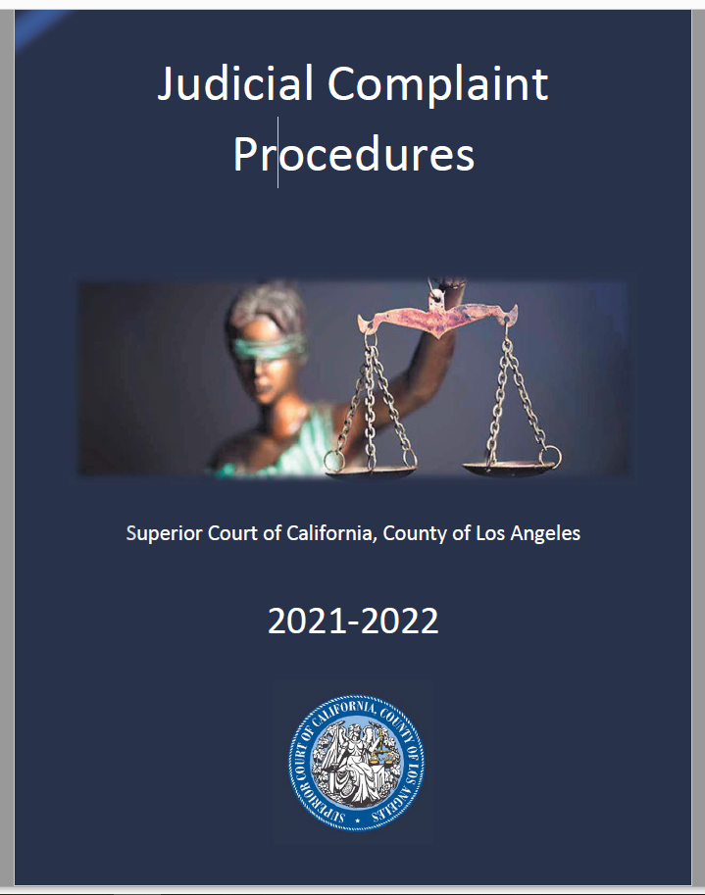
Judicial Complaint Procedures
Review, assess, and investigate alleged wrongdoing/misconduct
Document investigation to demonstrate due diligence
Seek guidance from Presiding Judge’s Office or Court Counsel
Respond to complainant in writing

Slide 15
Judicial Complaint Procedures
Legal & Other Issues
What is the scope of the investigation?
Due diligence requirements (prompt, fair, etc.)
Ex parte communications in pending cases
See CJEO Formal Opinion 2020-015 Supervising Judge’s Duties When a Party Complains about a Judge in a Pending Matter
Logistical issues (ordering transcript/audio recording, scheduling witness interviews, outside witnesses, language barriers, etc.)
Labor issues (Court employees, DAs, PDs, Bailiffs, etc.)
Reputational concerns, etc.

Slide 16
Judicial Complaint Procedures
Remember
No SJ authority to overrule or change the decision of another judicial officer or to attempt to affect the outcome in a case pending before another judicial officer.
No SJ authority to disqualify a judge from continuing to preside over a case.
If you decide to close a complaint in whole or in part because it relates to a permissible exercise of judicial or administrative discretion, you must note the basis for doing so. (Rule 10.703(h).)

Slide 17
Judicial Complaint Issues
Ethical violations vs. legal error
Anonymous, oral, or emailed complaints
Hybrid complaints
JO and staff/justice partner,
JO and administrative issues (e.g., filing issues, ADA, language access, jurors))
Investigating complaints in pending cases
Complaints against assigned judges or temporary judges
What constitutes appropriate corrective action?
Responding to complaint
Record Keeping

Slide 18
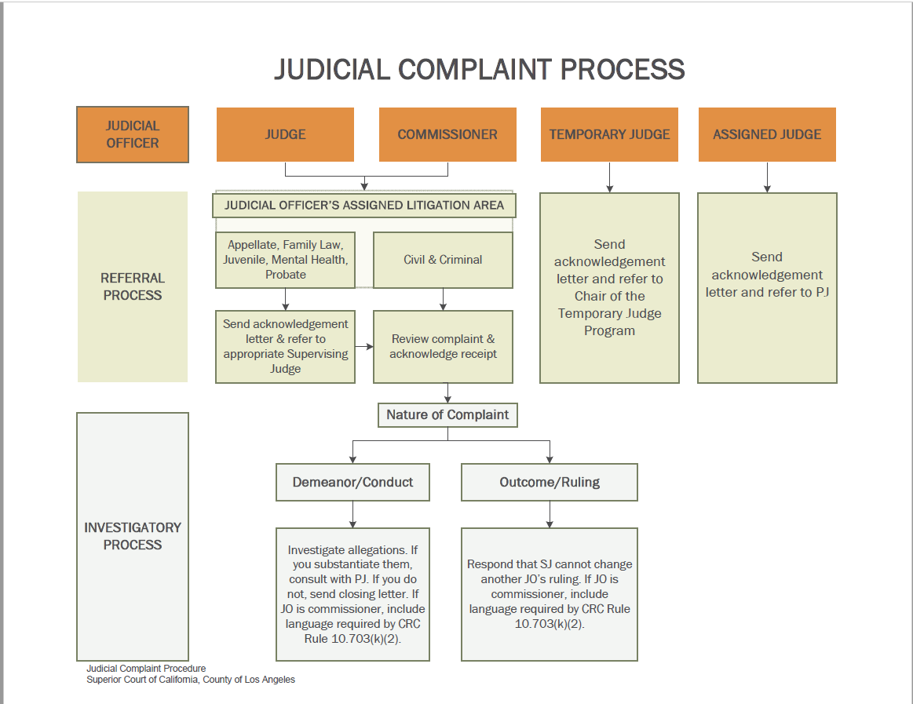

Slide 19
Presiding Judge’s Role in Judicial Discipline is Limited
Rule 10.603(c)(4)(A):
Notify the CJP of :
A judge’s substantial failure to perform judicial duties, including any habitual neglect of duty, persistent refusal to carry out assignments as assigned by the presiding judge, or persistent refusal to carry out the directives of the presiding judge as authorized by the rules of court; or
Any absences caused by disability totaling more than 90 court days in a 12-month period, excluding absences authorized under (c)(2);

Slide 20
Presiding Judge’s Role in Commissioner Discipline
Rule 10.703(k)(1):
If after a formal investigation under (j) the complaint results in the written reprimand, suspension, or removal of the subordinate judicial officer for conduct that if alleged against a judge would be within the jurisdiction of the commission under article VI, section 18 of the California Constitution, the presiding judge must promptly forward to the commission a copy of the portions of the court file on the complaint that reasonably reflect the basis of the action taken by the court, including the complaint and the subordinate judicial officer’s response.

Slide 21
Obligation to Cooperate with CJP
Government Code section 68725 –
“State and local public bodies and departments, officers and employees thereof, and officials and attaches of the courts of this State shall co-operate with and give reasonable assistance and information to the commission and any authorized representative thereof, in connection with any investigations or proceedings within the jurisdiction of the commission.”
Canon 3D(4) –
“A judge shall cooperate with judicial and lawyer disciplinary agencies.”
Rules of Com. on Jud. Performance, rule 104(a) –
“(a) A respondent judge shall cooperate with the commission in all proceedings in accordance with Government Code section 68725. The judge’s cooperation or lack of cooperation may be considered by the commission in determining the appropriate disciplinary sanction or disposition as well as further proceedings to be taken by the commission but may not be considered in making evidentiary determinations.”
Canon 3D(5) –
“A judge shall not retaliate, directly or indirectly, against a person known* or suspected to have assisted or cooperated with an investigation of a judge or a lawyer.”

Slide 22
Standard for Judicial Conduct
The Supreme Court has held that “[t]he ultimate standard for judicial conduct must be conduct which constantly reaffirms fitness for the high responsibility of judicial office.”
Geiler v. Commission on Judicial Qualifications (1973) 10 Cal. 3d 270, 281.

Slide 23
Corrective Action for Judicial Officers
“Most often, the appropriate corrective action entails counseling the offending judge and putting mechanisms in place to ensure that there is no reoccurrence of the inappropriate conduct.” Cal. Judges Assn., Formal Ethics Opn. 64 (2009), p. 3.

Slide 24
Corrective Action for Judicial Officers
Factors to consider are:
The seriousness of the violation;
The pervasiveness of the conduct;
The judge’s amenability to correcting his/her behavior;
The likelihood of repeat violations and difficulty of discerning the likelihood of new violations (mistreatment of staff, for example);
A prior history of discipline.
Cal. Judges Assn., Formal Ethics Opn. 64 (2009), p. 4.

Slide 25
When does Court report judicial misconduct to CJP?
“In some situations one of these factors alone may warrant reporting the matter to the CJP; in others a combination of factors may lead to that conclusion. A single incident of egregious misconduct may require referral to the CJP, even where none of the other factors apply. On the other hand, conduct that would not normally warrant reporting to the CJP may need to be reported where the judge is unwilling or unable to correct his/her conduct. And, of course, if the nature of the conduct is such that CRC 10.603(c)(4)(A) requires the presiding judge to report it, the presiding judge has no discretion in the matter.”
Cal. Judges Assn., Formal Ethics Opn. 64 (2009), p. 4
.
“Accountability is essential to personal growth, as well as team growth. How can you improve if you’re never wrong? If you don’t admit a mistake and take responsibility for it, you’re bound to make the same one again.” — Pat Summitt

